Slide 1
Python in Geosciences
Landscape evolution modelling using python
Ramendra Sahoo
Earth Process Modelling Division

Slide 2
Example slide of a fluvial landscape

Slide 3
Parametrization of fluvial processes

Slide 4
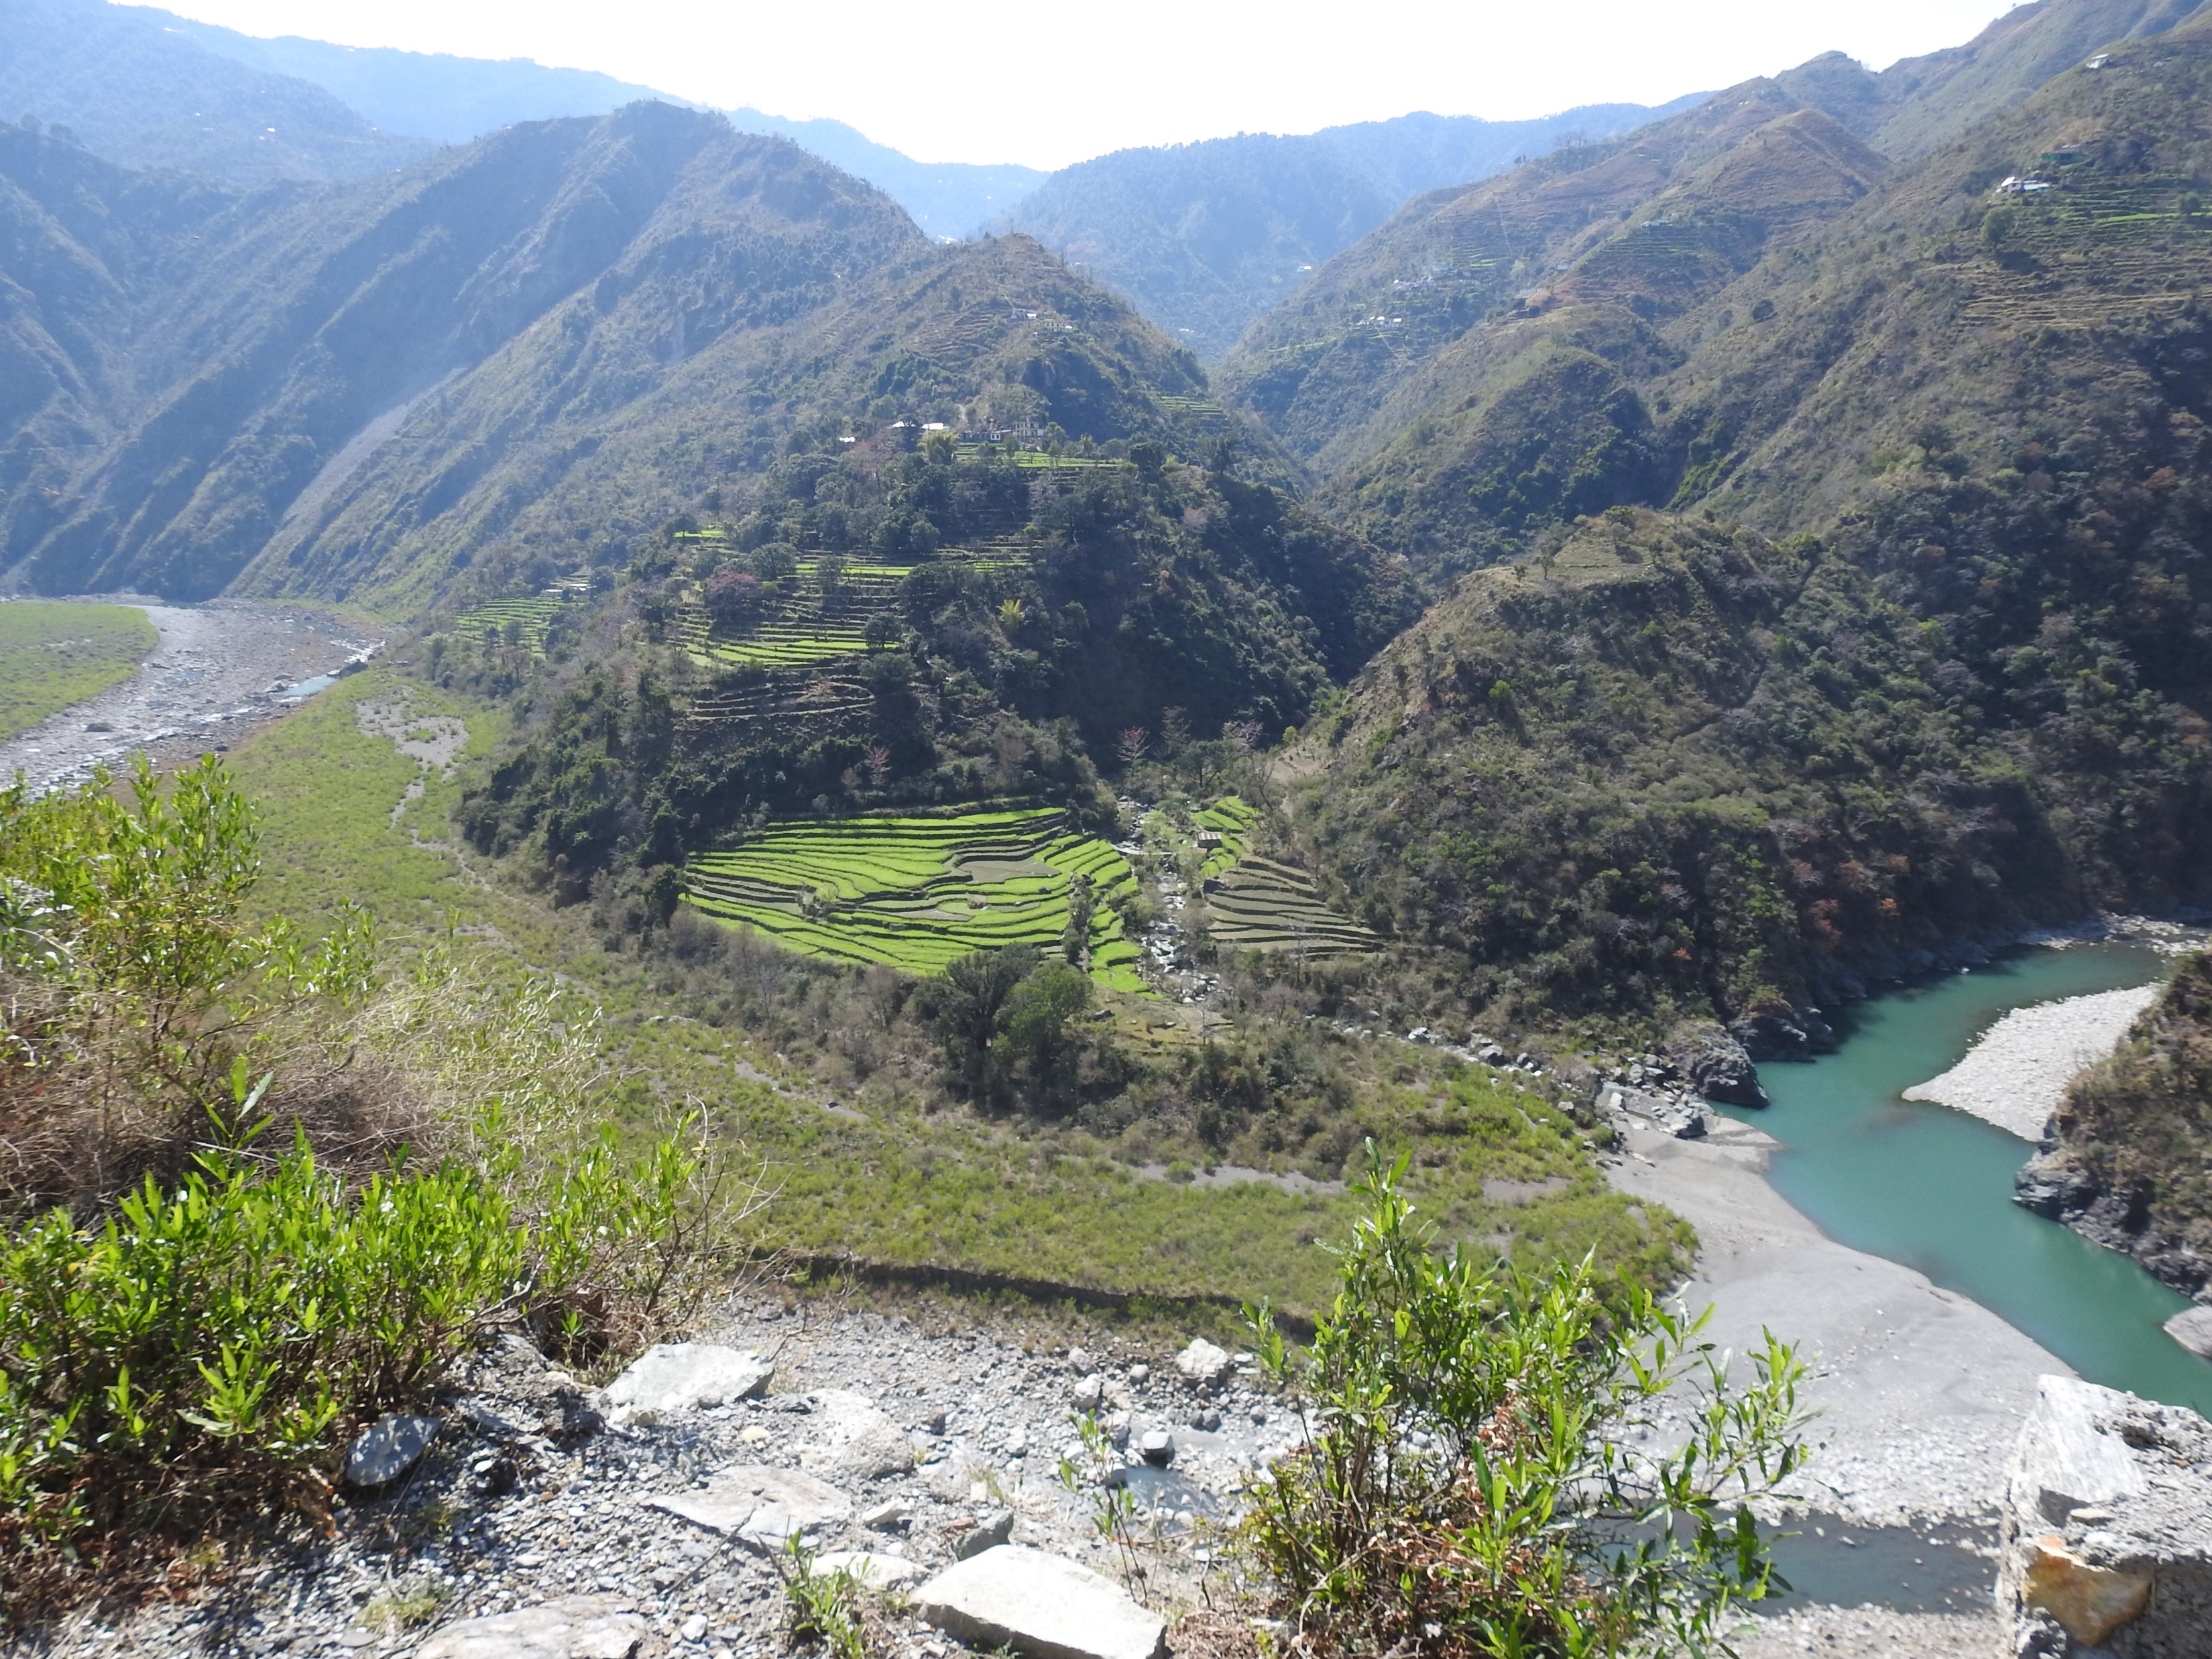
Colluvium

Slide 5
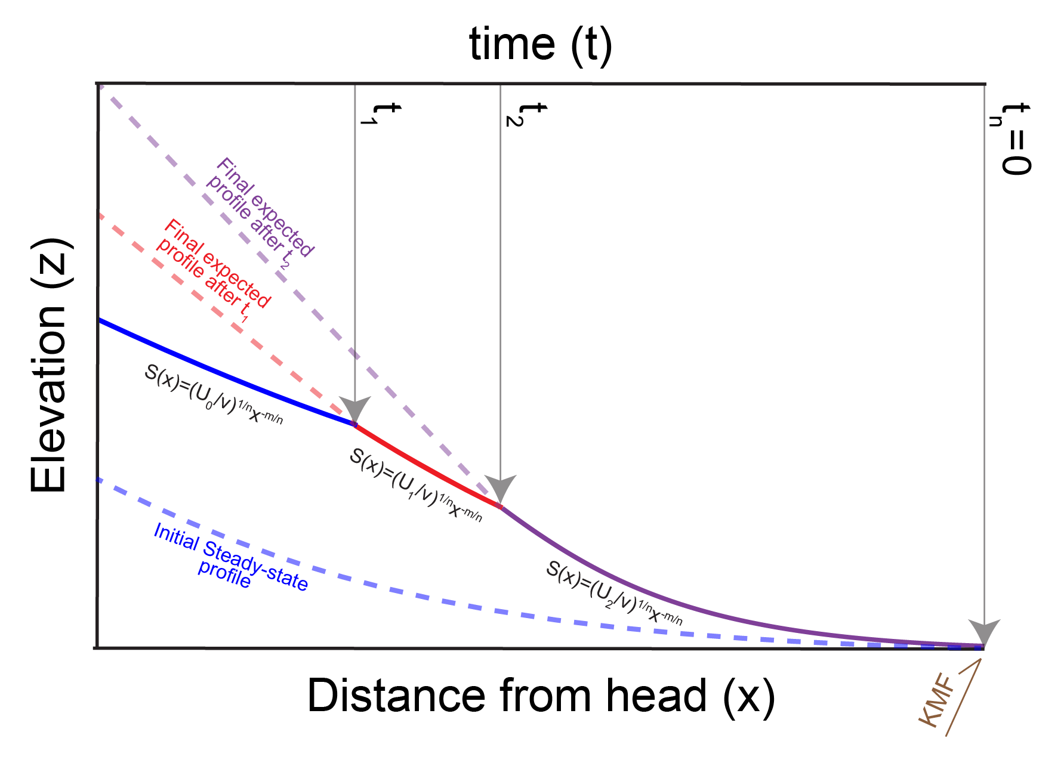
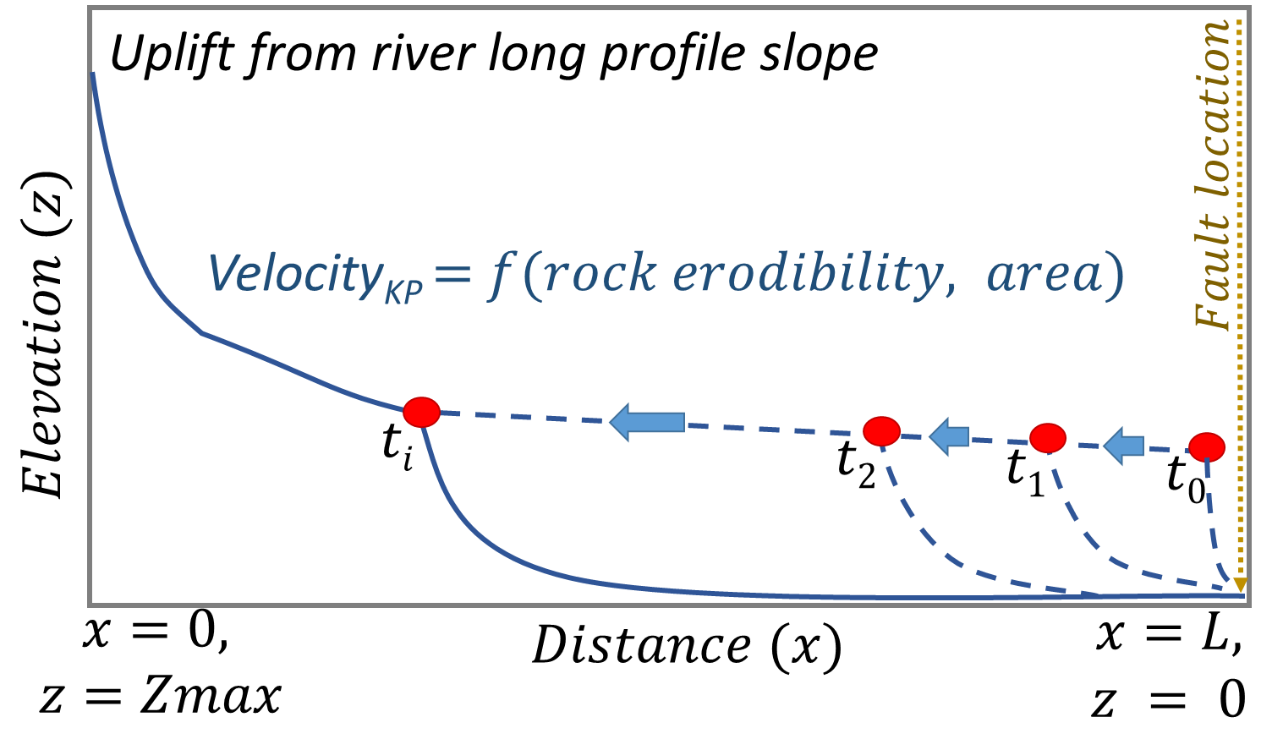
method
U
Hanging Wall
Foot Wall
$\frac{∂z}{∂t}=U\left(x,t\right)−E\left(x,t\right)…(1)$
$$E=k∙A^{m}∙{\left(\frac{∂z}{∂x}\right)}^{n}\text{…(2)}$$
$$z\left(t,x\right)=\int_{t−τ(x)}^{t}{U\left[t^{′},τ^{−1}(τ\left(x\right)−t+t^{′})\right]dt^{′}}$$
$U=U_{p}+{\left(A^{T}A+δ^{2}I\right)}^{−1}A^{T}(z−A$ $U_{p}$)
$$z_{i}=\sum_{j=1}^{q}{U_{j}{∆t}_{j}}, A∗U=z$$

Slide 6
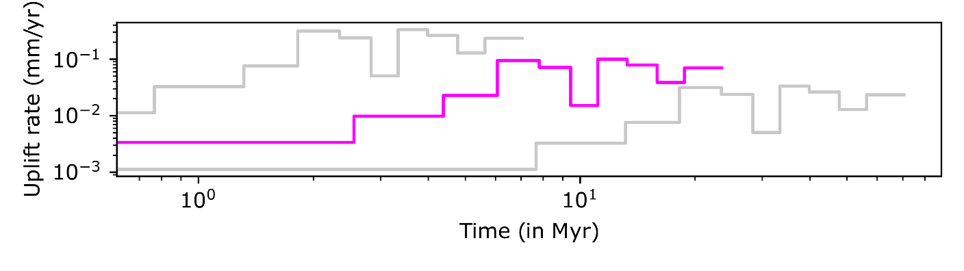
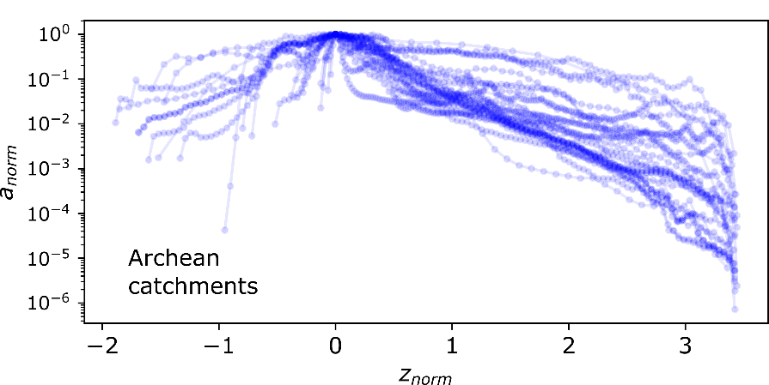
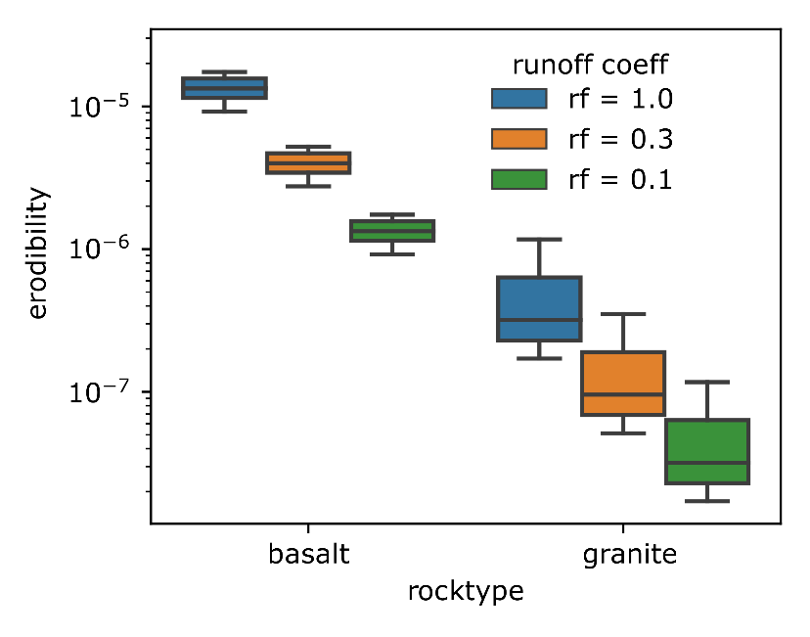
Landscape response to passive tectonics
$$z_{i}=\sum_{j=1}^{q}{U_{j}{∆t}_{j}}, z=AU$$
$$∂_{t}a=−∂_{z}\left(Ua\right)+∂_{z}\left(Ea\right)$$
$$E\left(z\right)=kq\left(z\right)s(z)$$
$$a=a_{0}e^{−z/λ}$$
Order of magnitude difference in theoretical response time based on rock type
Two main phase of uplift or accelerated denudation record, at ~15 Ma and ~6-7 Ma
Supports denudation driven flexural isostasy theory as the major mode of uplift
$$T_{R}=\frac{λ}{U}=\frac{1}{kPΔz}$$
Innovation
Development of computer program for river profile inversion, independent estimate of erodibility from hypsometric analysis
Contribution
Ideation, Design of methodology, Software development, data analysis, writing original draft

Slide 7
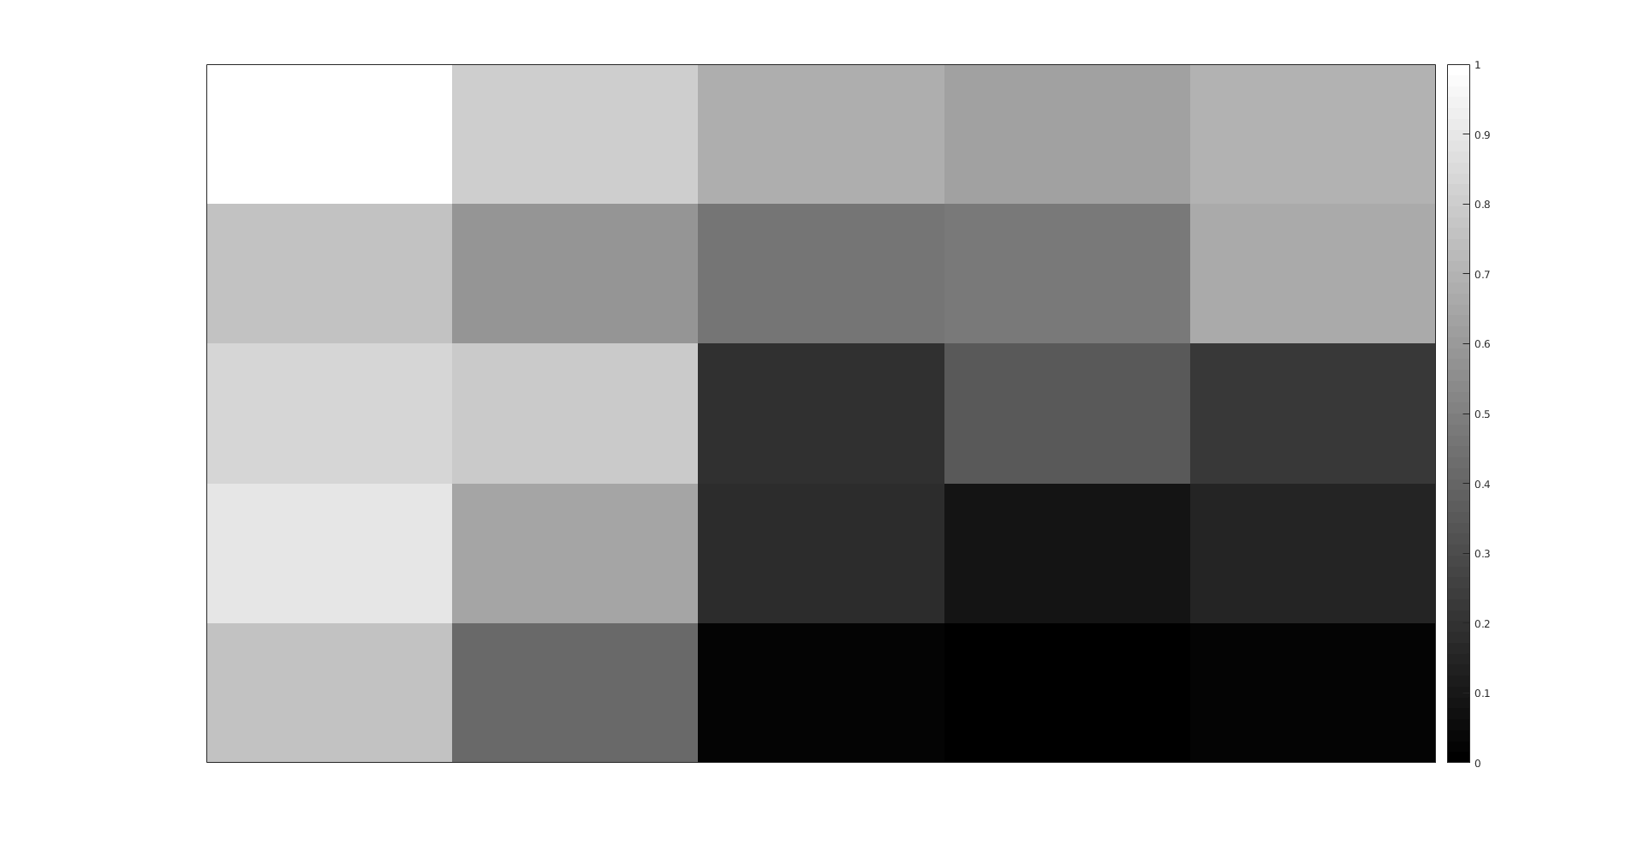
Methodology to obtain Long Profile of a river
67 | 56 | 49 | 46 | 50
53 | 44 | 37 | 38 | 48
58 | 55 | 22 | 31 | 24
61 | 47 | 21 | 16 | 19
53 | 34 | 12 | 11 | 12
0 | 0 | 0 | 0 | 0
0 | 3 | 2 | 2 | 0
0 | 0 | 11 | 0 | 1
0 | 0 | 1 | 15 | 0
0 | 2 | 5 | 24 | 1
32 | 64 | 128
16 |  | 1
8 | 4 | 2
1. DEM Elevation Values
2. Flow Direction
3. Flow Accumulation
0 | 0 | 0 | 0 | 0
0 | 1 | 1 | 1 | 0
0 | 0 | 1 | 0 | 0
0 | 0 | 0 | 1 | 0
0 | 1 | 1 | 1 | 0
0 | 0 | 0 | 0 | 0
0 | 1 | 1 | 1 | 0
0 | 0 | 1 | 0 | 0
0 | 0 | 0 | 1 | 0
0 | 1 | 1 | 1 | 0
D8 algorithm:
flow direction
6. Long Profile
5. Least Cost Path
4. Network

Slide 8
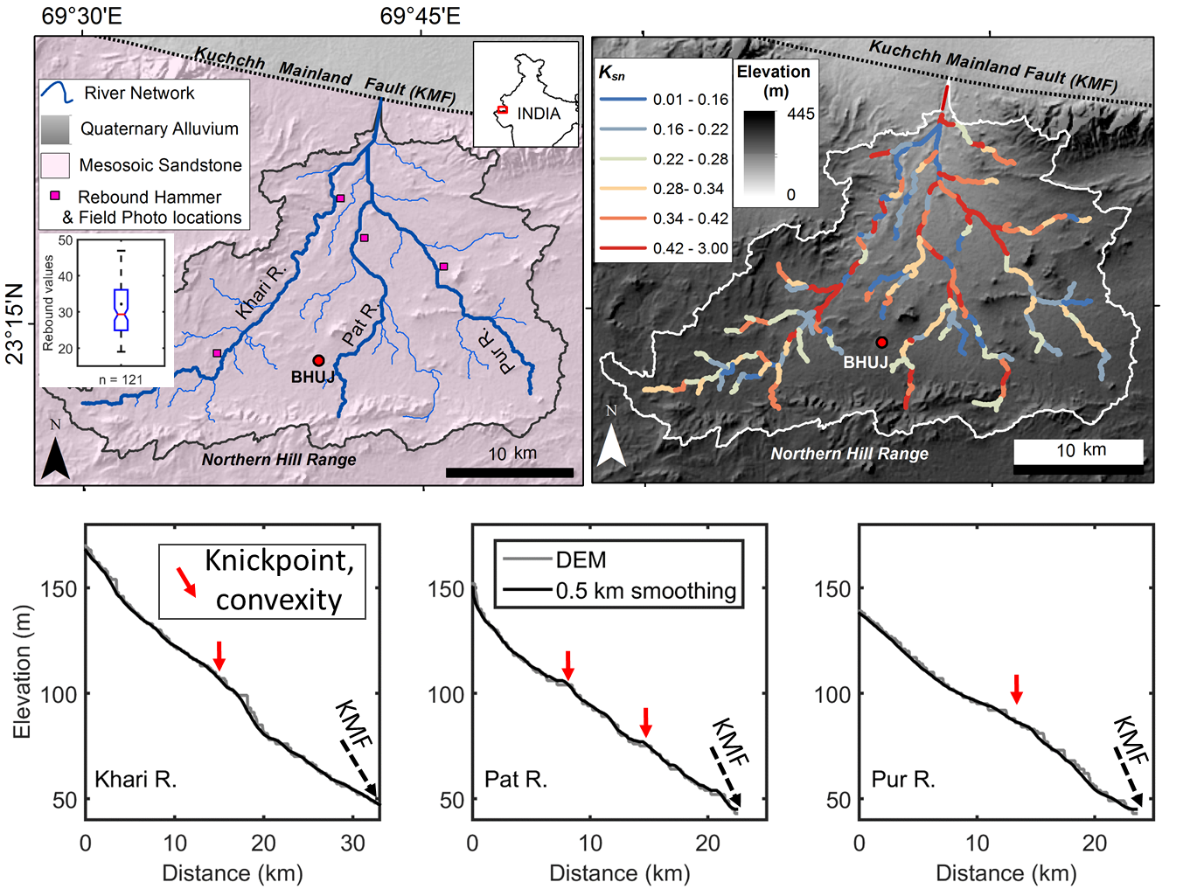
Long profile and normalized steepness index
River long profiles are excellent markers of tectonics when active structures run across it.
Under conditions of homogeneous lithology, climate and a spatially uniform uplift, the changes in slope (S) of the river reach in response to uplift (U) at any point of time leads to an increase in erosive capacity of the steepened reach called knickpoint (KP).
Assuming no diffusion, uplift signals are preserved in the form of KP in the river long profile (LP).
The LP inversion technique by Pritchard et al. (2009) is based on the analytical solution of the widely used stream power incision model:
$$\frac{∂z}{∂t}=U_{t}−k A^{m′}{\left|S\right|}^{n}$$

Slide 9
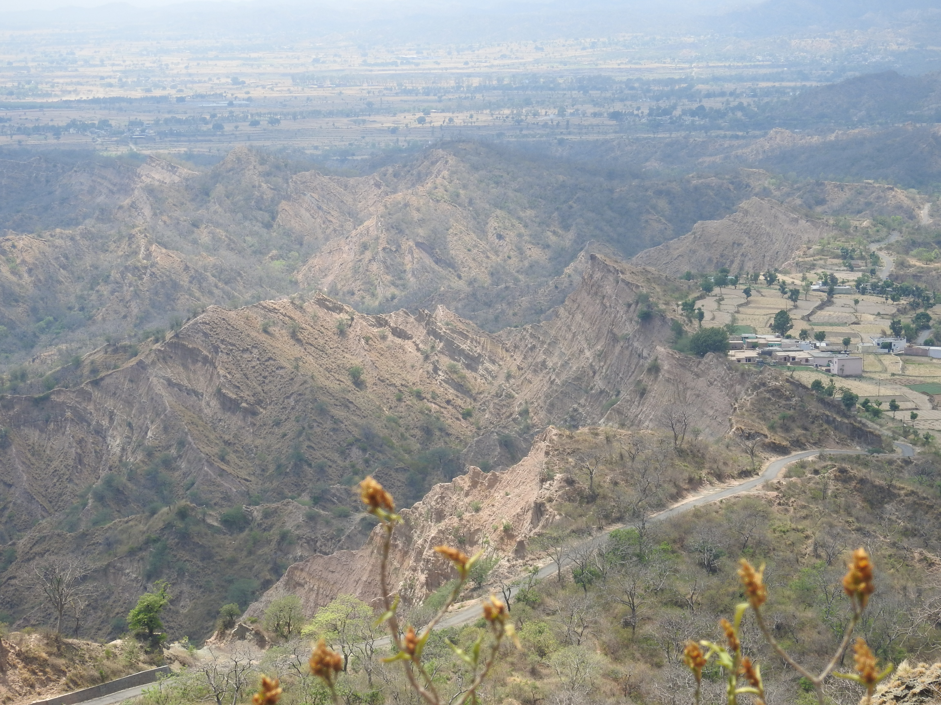

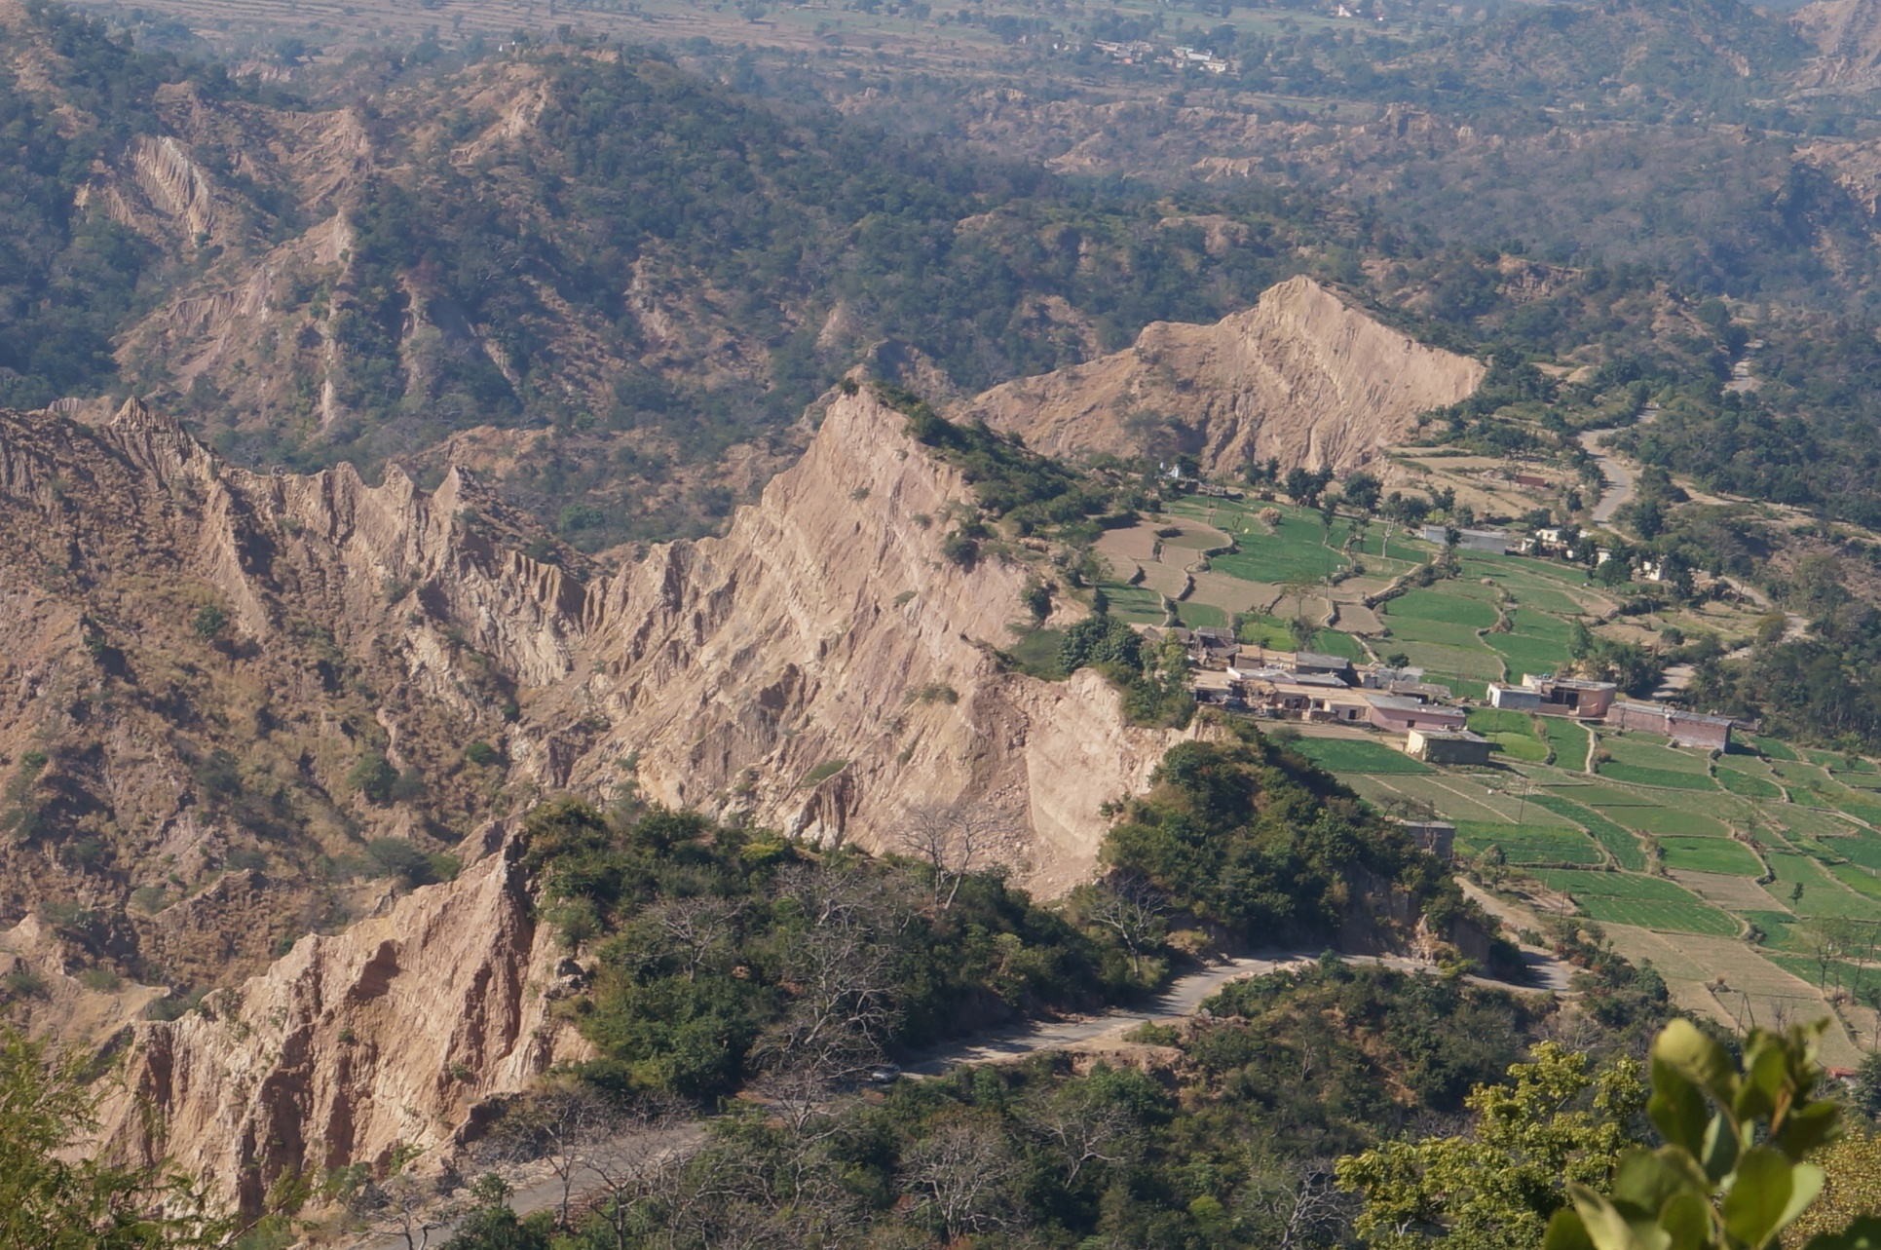
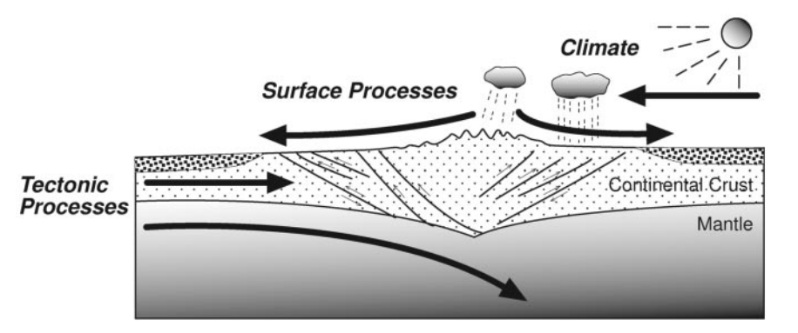
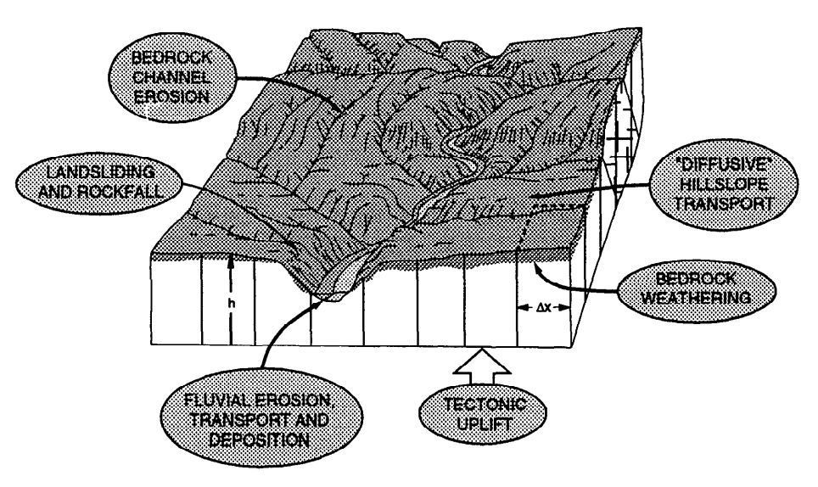
Morphotectonic variability along the Nahan Salient, NW Himalaya and its control on landscape evolution pattern
SW
NE
Presented By:
Rahul Kumar Kaushal
PhD scholar
Earth Sciences
Supervisor: Dr. Vikrant Jain

Slide 10
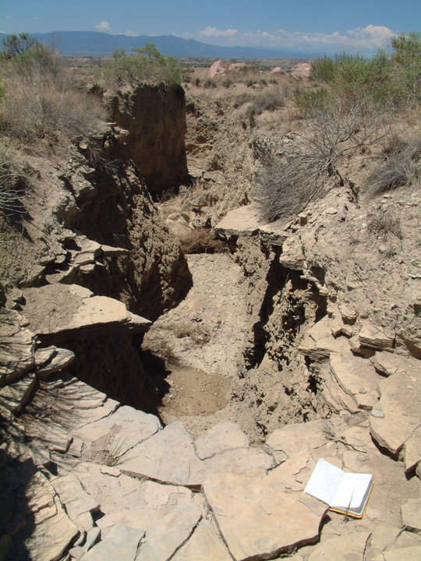
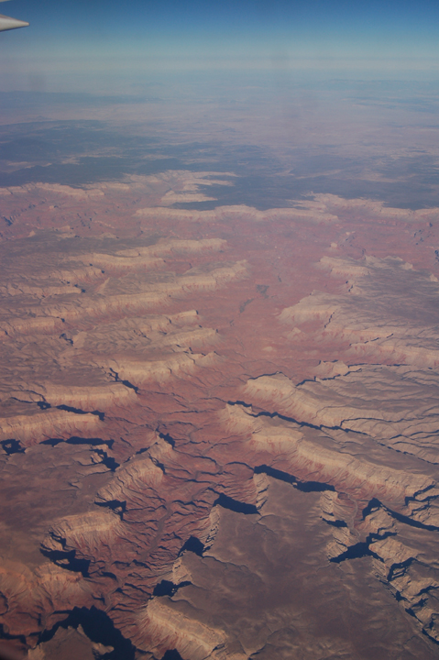
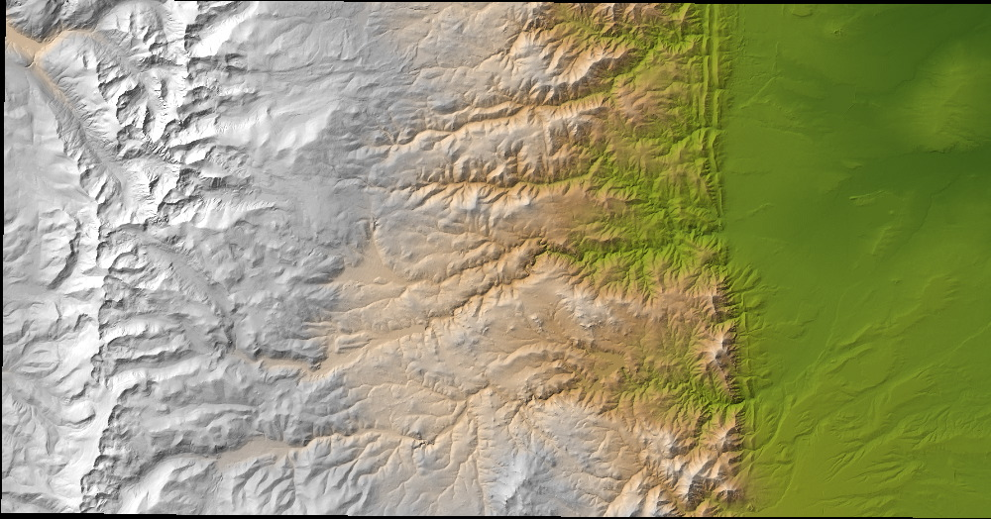
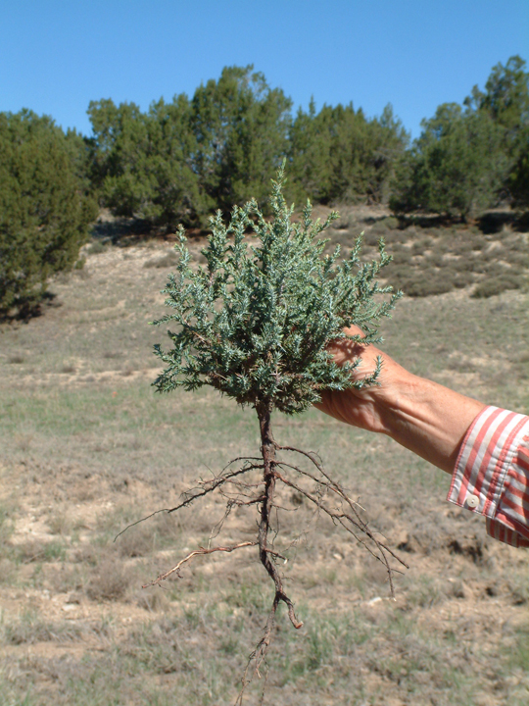
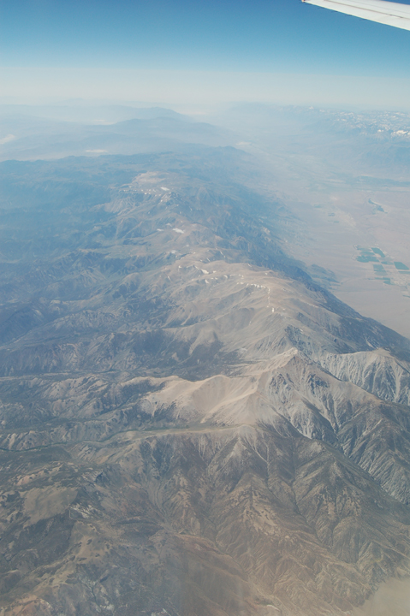
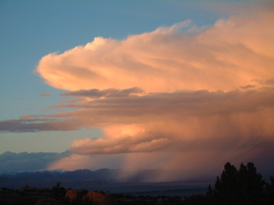
EROSION AND DENUDATION
WHAT ARE THE MAJOR CONTROLS?
PROCESSES
MATERIALS
CLIMATE
LIFE (+ HUMANS)
TECTONICS

Slide 11
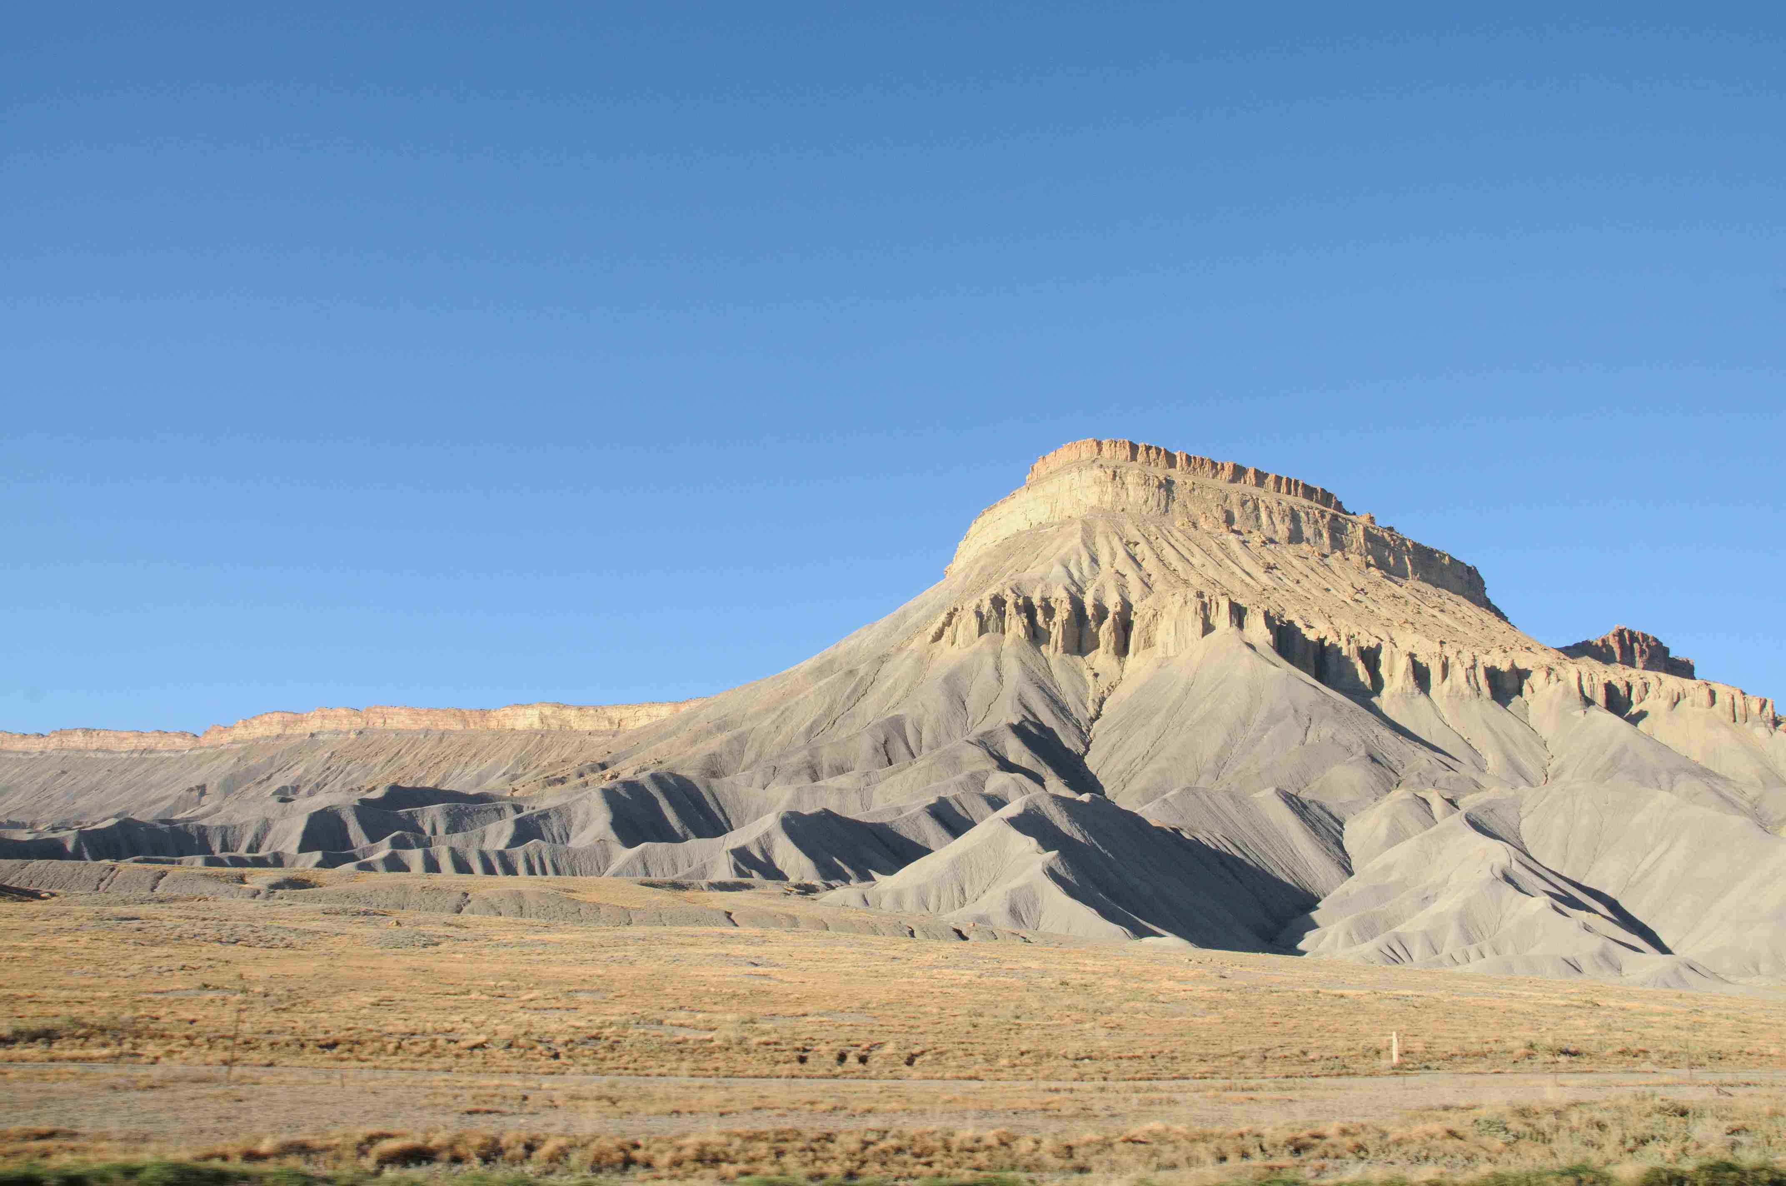
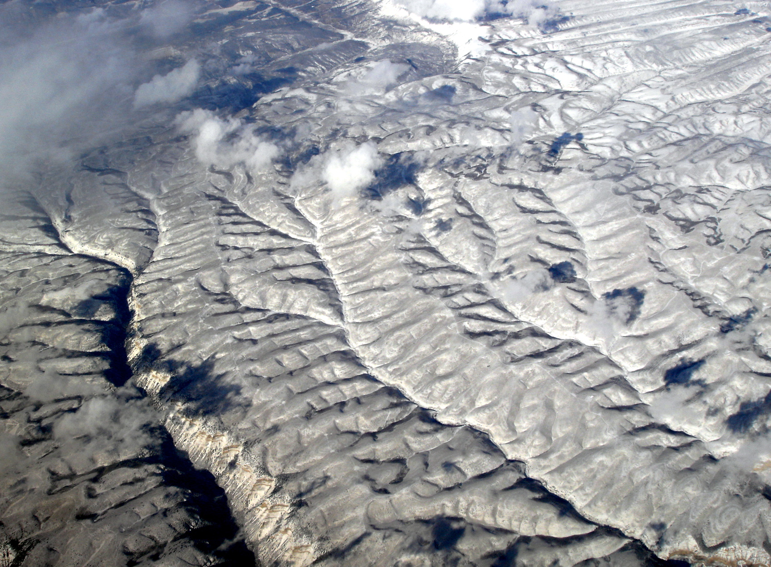
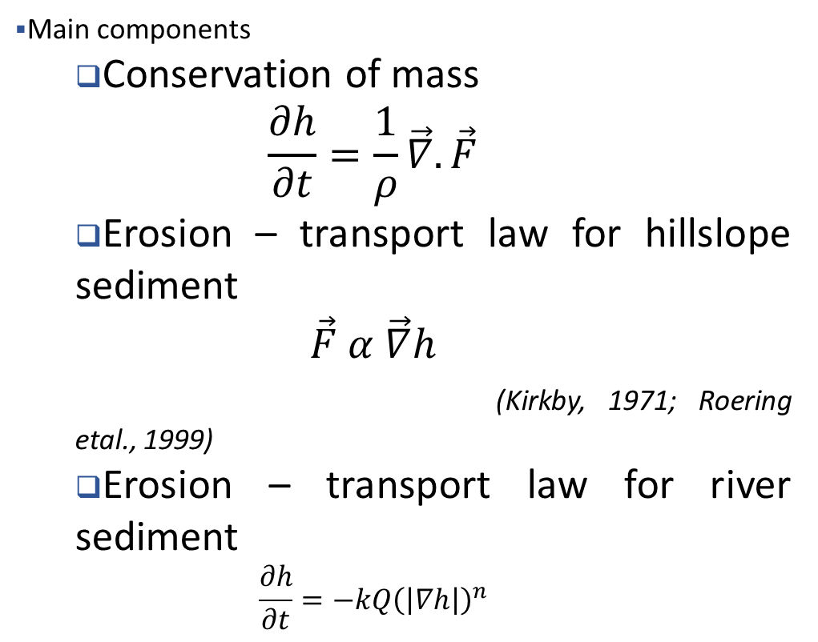
Landscape Evolution Model
Definition: mathematical theory describing how the actions of various geomorphic processes drive the evolution of topography over time.
Reference: Tucker & Hancock, 2010. Modelling landscape evolution. Earth Surface Processes and Landforms
Main components
Conservation of mass
$$\frac{∂h}{∂t}=\frac{1}{ρ}\vec{∇}.\vec{F}$$
Erosion – transport law for hillslope sediment
$$\vec{F} α \vec{∇}h$$
(Kirkby, 1971; Roering etal., 1999)
Erosion – transport law for river sediment
$$\frac{∂h}{∂t}=−kQ{\left(\left|∇h\right|\right)}^{n}$$
Hillslopes
Stream and River Transport

Slide 12
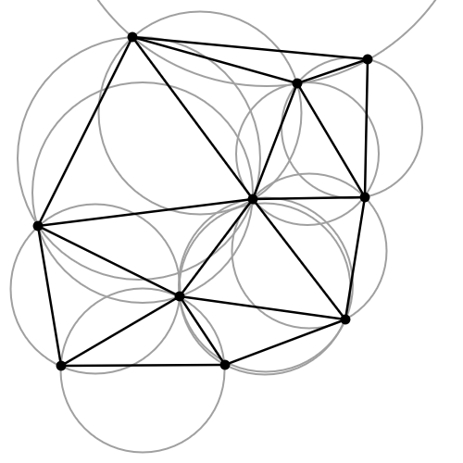
What governs the process – response interaction??
$$\frac{∂h}{∂t}=U−kQ{\left(\left|∇h\right|\right)}^{n}………(i)$$
$$\frac{∂h}{∂t}=D∆h−kA^{m}{\left(\left|∇h\right|\right)}^{n}+U−S………(ii)$$
$$\frac{∂h}{∂t}=D\left(∇(f(\left|∇h\right|\right))−kQ{\left(\left|∇h\right|\right)}^{n}+U−S………(iii)$$
where, $h=surface elevation$
$U=tectonic uplift rate, S=Subsidence rate$
$k=surface erodibility$
$D=Hillslope diffusivity, Q=Discharge$
$P=Annual precipitation rate, I=Infiltration rate$
No Non-linearity
$$g\left(P, I\right)(Hortonian flow regime)$$

Slide 13
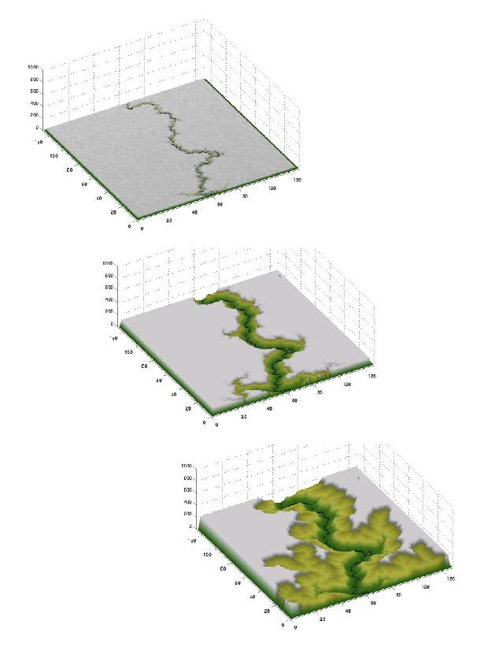
Landscape evolution model
Continuity of mass:
(e.g., Kirkby, 1971)
Transport / erosion laws:
(e.g., Dietrich et al., 2003)
Gravity-driven
(e.g., landslides)
Water-driven
(e.g., river networks)

Slide 14
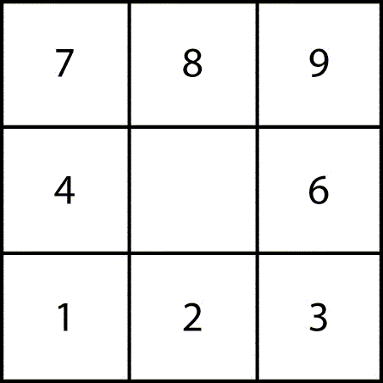
‘D8 Algorithm’ for Drainage
We assume that water and mass flows into the
direction of the steepest slope:
COI
S = slope [-]
Δz= z_coi – z_neighbor [L]
d = distance [L]
What are the lengths, d, for the two potential drainage directions?

Slide 15
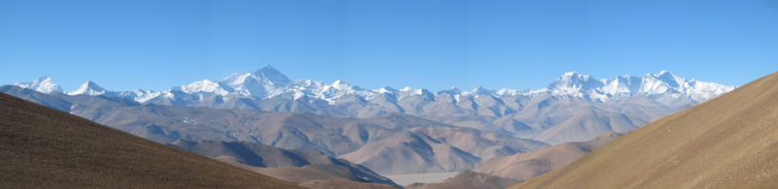
Tectonic Geomorphology
Surface and subsurface processes
Cause
Effect
Schumm et al., 2000; Killer and Pinter, 2002
Tectonic, Climate
Landscape
Neotectonics
Qualitative and
Quantitative
Slope (s)
Landscape Pattern
Indices, other proxies
Landscapes are shaped by movements of mass
How those landforms combine to form landscapes

Slide 16
Method

Slide 17
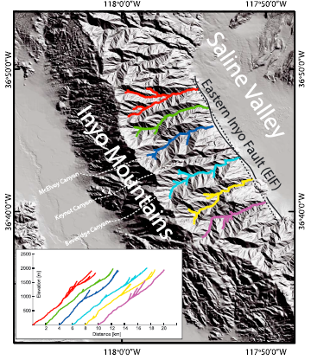
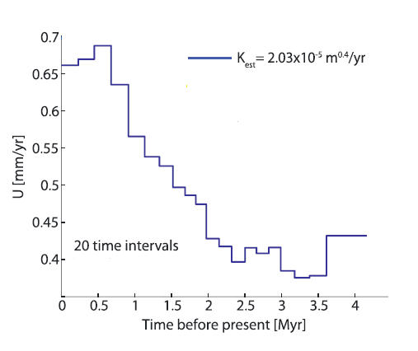
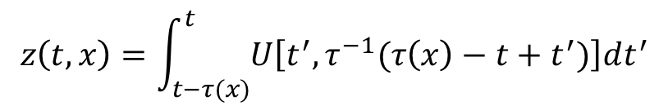
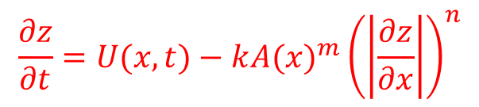
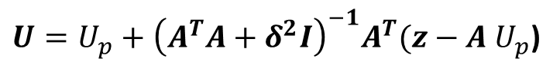
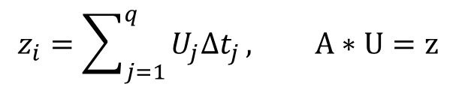
U
Hanging Wall
Stream power model
Foot Wall
$$\frac{∂z}{∂t}=U(x,t)−k{A(x)}^{m}{\left(\left|\frac{∂z}{∂x}\right|\right)}^{n}$$
$$z\left(t,x\right)=\int_{t−τ(x)}^{t}{U\left[t^{′},τ^{−1}(τ\left(x\right)−t+t^{′})\right]dt^{′}}$$
$$z_{i}=\sum_{j=1}^{q}{U_{j}{∆t}_{j}}, A∗U=z$$
$U=U_{p}+{\left(A^{T}A+δ^{2}I\right)}^{−1}A^{T}(z−A$ $U_{p}$)
Goren et al., 2014

Slide 18
Landscape evolution modeling

Slide 19
Few geomorphic markers and indices

Slide 20
Inversion of river profiles

Slide 21
Thank you

